Slide 1


Unlocking project potential
Chengetai Dziwa
June 2025

Slide 2

Monitoring and Evaluation
Monitoring: Regularly collecting and analyzing information to track progress toward your goals.
Evaluation: Systematically assessing a project's design, implementation, and outcomes to determine its effectiveness/efficiency.
M&E helps ensure your bread-baking process is on track to achieve the perfect loaf by systematically tracking progress, making informed adjustments, and assessing outcomes.

Slide 3
Monitoring and Evaluation cont’d
Why?
Accountability: Demonstrates responsible use of resources.
Learning: Provides insights to improve future projects.
Decision Making: Informs strategic adjustments and future planning.
Reporting: Offers evidence of progress and success to stakeholders.
How?
Indicators: Specific, measurable signs of progress.
Baseline Data: Initial data against which progress is measured.
Monitoring Plan: Schedule and methods for regular data collection.
Evaluation Plan: Framework for assessing project outcomes and impact.
Data Collection Methods: Tools and techniques for gathering information.
Analysis and Reporting: Processes for interpreting data and sharing findings.

Slide 4
Theory of Change
Long-term Goal: The ultimate change you aim to achieve.
Outcomes: Short, medium, and long-term changes to reach the goal.
Interventions: Activities or strategies implemented to achieve outcomes.
Assumptions: Conditions that need to be in place for success.
Indicators: Metrics to measure progress.
Believe
Do
Get
Knowledge
Strategy
Results

Slide 5
Outcomes are about change…
Intervention projects are designed, planned, and implemented to produce (positive) change in the target group (intended beneficiaries).
It can be fairly straightforward e.g., clean water through a community borehole or complex such as resilient and empowered adolescents.
Types of change:
  Improved understanding of advocacy (knowledge gain)
  Youth advocates better equipped to design advocacy plans (better skills)
  Youth advocates are better informed on the priorities of funding partners (increased level of information)

Slide 6
Example
Long-term Goal: Increased literacy rates in a community.
Outcomes:
  Short-term: Increased enrollment in literacy programmes.
  Medium-term: Improved reading and writing skills.
  Long-term: Higher literacy rates in the community.
Interventions:
  Conduct community awareness campaigns.
  Provide training for literacy teachers.
  Establish after-school reading programmes.
Assumptions:
  Community values education.
  Sufficient funding and resources available.
  Qualified teachers are willing to participate.
Indicators:
  Number of new enrollments in literacy programs.
  Test scores in reading and writing.
  Survey results on community literacy levels.

Slide 7
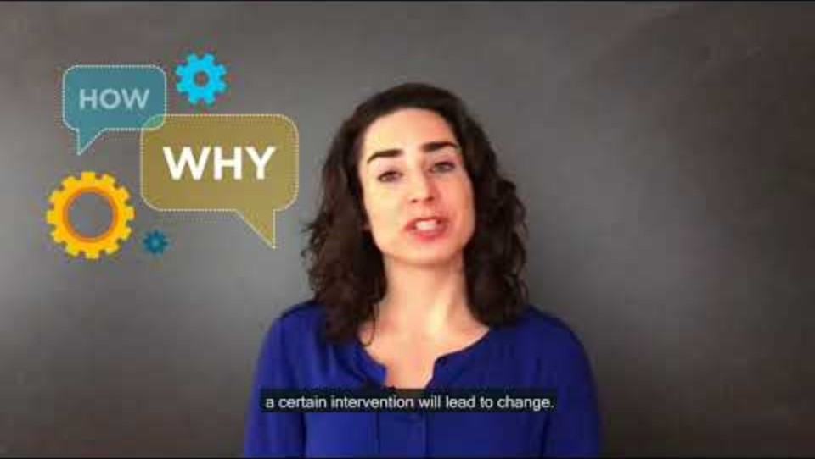
Section Title

Slide 8
Group work
Imagine you have a small project and in your groups do the following:
  Define the Long-term Goal
  Identify Outcomes:
  Design Interventions:
  Articulate Assumptions:
  Develop indicators
  On a flipchart, draw the Theory of Change diagram linking activities, outcomes, and the long-term goal. Use arrows to show the relationships and you can also add sticky notes for each element.

Slide 9

Section Title

